Slide 1

Predicting a Patient's Breast Cancer Diagnosis Using Data Mining Techniques
Departments of Information Systems and Decision Sciences
Experimental Statistics
E.J. Ourso College of Business
Louisiana State University
Bethany Smith
October 16, 2017

Slide 2
Agenda
Background
Purpose
Data Description and Preparation
Variable Reduction Process
Predictive Modeling Process
Conclusions and Recommendations

Slide 3
Background
Breast cancer is a major health problem that represents a significant worry for many women and their physicians (de la Iglesia, Potter et al. 2011).
Second leading cause of cancer deaths among women in the United States.
It is estimated that nearly 15% of newly-diagnosed breast cancer patients will die each year. (American Cancer Society. (2017))

Slide 4
Current Diagnostic Methods
Fine needle aspiration (FNA) with visual interpretation
Sensitivity to vary between 65% and 95%
Surgical Biopsy
Sensitivity, near 100%. (The highest sensitivity of all three methods)
Researchers have been attempting to find a way to improve the sensitivity of both mammography and Fine Needle Aspiration (FNA).
Notes:
Talk about process of mammogram to FNA to surgical biopsy
In the past for breast cancer diagnostics the process was …..
The goal is to see if the less costly and less invasive FNA procedure can be used as an adequate alternative to a surgical biopsy.
Replacing the invasive and costly biopsy procedure with similar diagnostic results (accuracy) alternative would be a huge advantage
Mammography - Age, breast density, and technology available all affect researches ability to improve sensitivity.
FNA- Rate of false negatives for FNA diagnosis is approximately 5% when combined with a clinical exam and a mammogram.
Surgical Biopsy- Rate of false negatives for FNA diagnosis is approximately 5% when combined with a clinical exam and a mammogram.

Slide 5
Purpose
Determine if the less costly and less invasive FNA procedure can be used as an adequate alternative to a surgical biopsy.
Build a predictive model using FNA results to diagnose breast cancer malignancy.
Identify the most significant characteristics of FNA that aid in accurate diagnosis.
Notes:
Accurately predict the presence of a malignant tumor using data from the diagnostic procedure Fine Needle Aspiration.

Slide 6
The Study
Fine Needle Aspiration Breast Cancer Diagnostics
Data used in diagnosing breast tumors based on fine needle aspirate
A small gauge needle was used to remove fluid directly from the breast lump/mass.
The fluid was then stained and placed on a glass slide to reveal the nuclei of those cells collected.
Notes:
(Managasarian, OL, et al, 1994)

Slide 7
Data Description & Preparation
30 Real Valued Features were computed for each cell nucleus
Radius - Mean of distances from center to points on the perimeter
Texture - Standard Deviation of Gray Scale Values
Perimeter
Area
Smoothness - Local Variation in Radius Lengths
Compactness - Perimeter squared / (area - 1.0 )
Concavity - severity of concave portions of the contour
Concave Points - number of concave portions of the contour
Symmetry
Fractal Dimension - coastline approximation - 1
Notes:
The mean, standard error and “worst” (largest mean of the three largest values) were computed for each image, resulting in 30 features for each observation.
Each FNA produces multiple measurements for each of these features

Slide 8
Data Description & Preparation
Number of Patients: 569
Target Variable diagnoses whether the breast mass was benign or malignant Diagnosis=Malignant (37%)
Diagnosis=Benign (63%)
Partitioned into training (70%) and validation (30%) subsets.
Notes:
because of the size of the data we want more in training

Slide 9
Data Reduction Phase
Notes:
im looking at 5 number of data reduction techniques

Slide 10
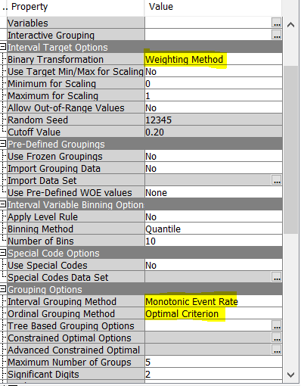

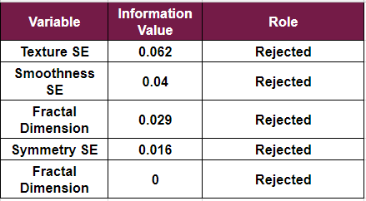
Initial Variable Reduction (WOE)*
WOE Approach
Information Value
the variable's ability to accurately classify an individual's mass as malignant or benign
The default IV cutoff of .10 was used
Total Variables Moving Forward : 25
Notes:
WOE measure the association between an input variable and target variable.
(IV) is used to evaluate a variable's overall predictive power
*change bottom fractal dimension to SE

Slide 11







Variable Reduction Process
Logistic Regression
Variable Selection
Variable Clustering
Variable Clustering Principle Components
Random Forest
Decision Tree
Notes:
These are the methods I explored in enterprise miner (all of them) these three methods :
Variable Selection
Variable Clustering
Principle Components
are the variable reduction techniques that were utilized in our final models
*ADD RANDOM FOREST
Principle components - Eigenvalue one criteria any principle component with an eigenvalue greater than or equal to 1 (5 principal components were selected)

Slide 12
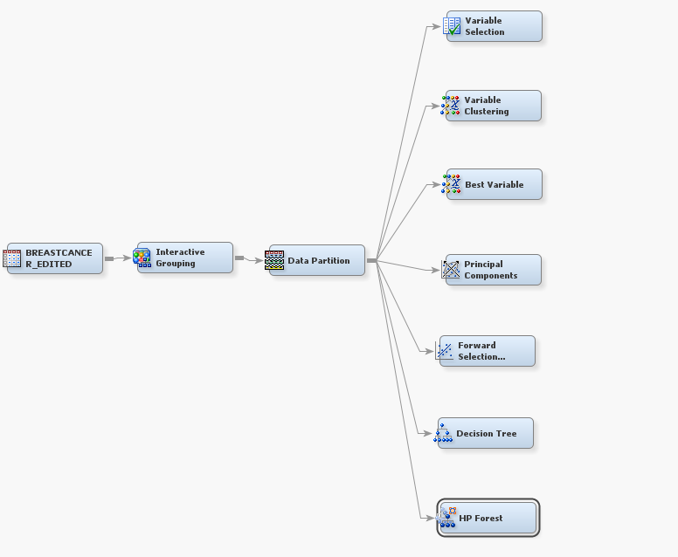
Variable Reduction Process
Notes:
Weight of Evidence was the initial variable reduction technique.
Those 25 weighted variables were then used as inputs for three seperate variable reduction techniques

Slide 13
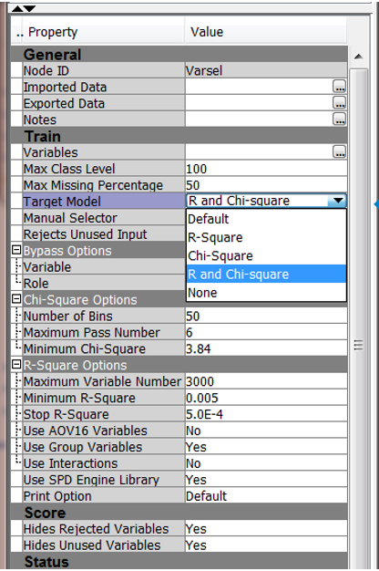

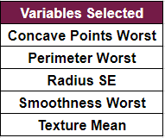
Variable Selection
Variables are selected based on their correlation with the target variable
All other variables were rejected based on a small R-square value and or a small Chi-Square Value
Reduced 25 Variables to 5
Notes:
Variable Selection is a variable reduction technique

Slide 14

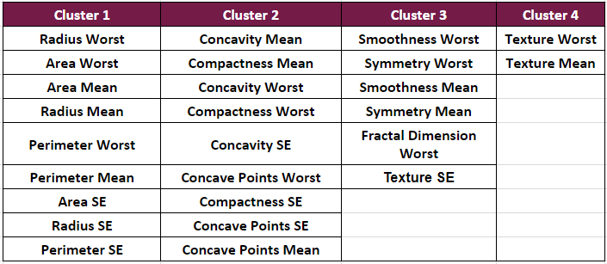
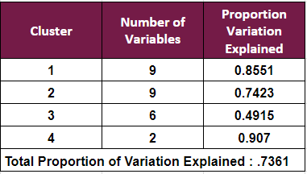
Variable Clustering
Groups correlated subsets of the original variables
Reduced 25 Variables to 4
Notes:
Another variable reduction technique
Selecting variables with minimal resulting collinearity
Exports a linear combination of the variables from each cluster
Cluster Components are the default setting

Slide 15
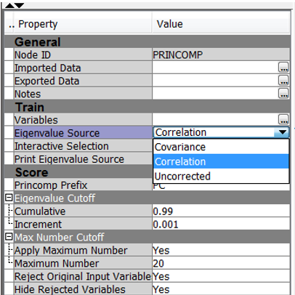
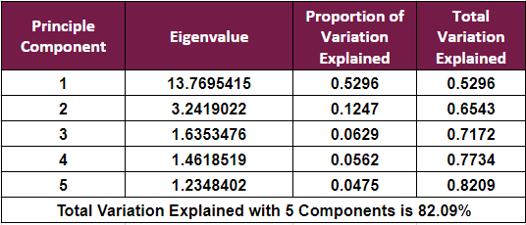

Principle Components
Uncorrelated linear combination of all input variables
Eigenvalue-one criterion
Reduced 25 Variables to 5
Notes:
This technique produces what are known as PC
Of which each principal component is linear comb of every variable used as an input
keep any components with an eigenvalue > 1

Slide 16
Modeling Approach

Slide 17
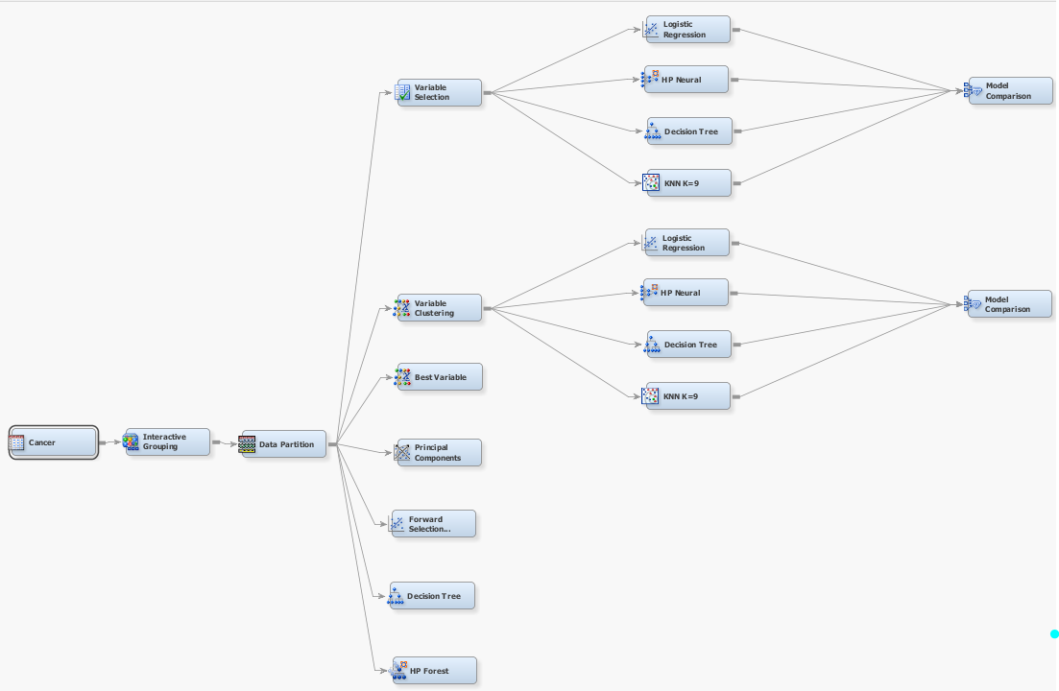
Modeling Approach Process

Slide 18
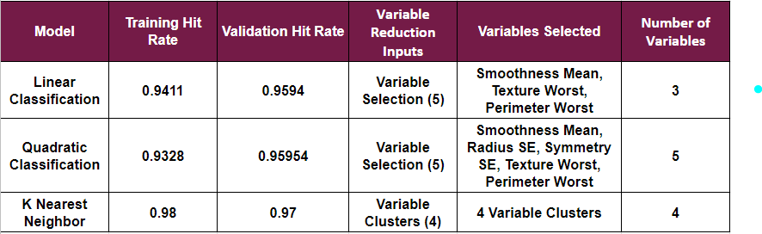
Method : Classic Models
Naivee Rule .63
Notes:
fix validation miss error rate and put as hit rate
take off full models bc redundant
All Full Models were run using all variables identified as important via WOE/IV
All Reduced Models were run with those 5 variables from the variable selection

Slide 19
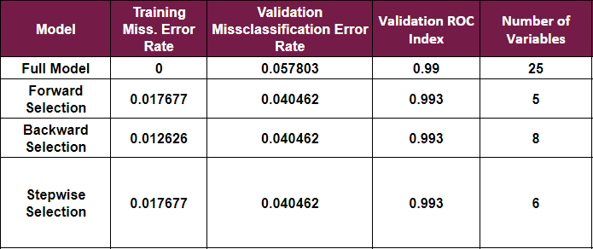
Logistic Regression
Naivee Rule .63
All 25 WOE Variables were used as inputs
Forward Selection Model is superior model
Variables : Concave Worst, Concave Worst, and Texture Worst, Smoothness Worst, Radius SE
Notes:
variable reduction approaches did not help as inputs into a logistic regression
best model overall was forward selection
Model Initially run using all variables in the data set.
The model was then run using each of the previously listed variable reduction technique

Slide 20
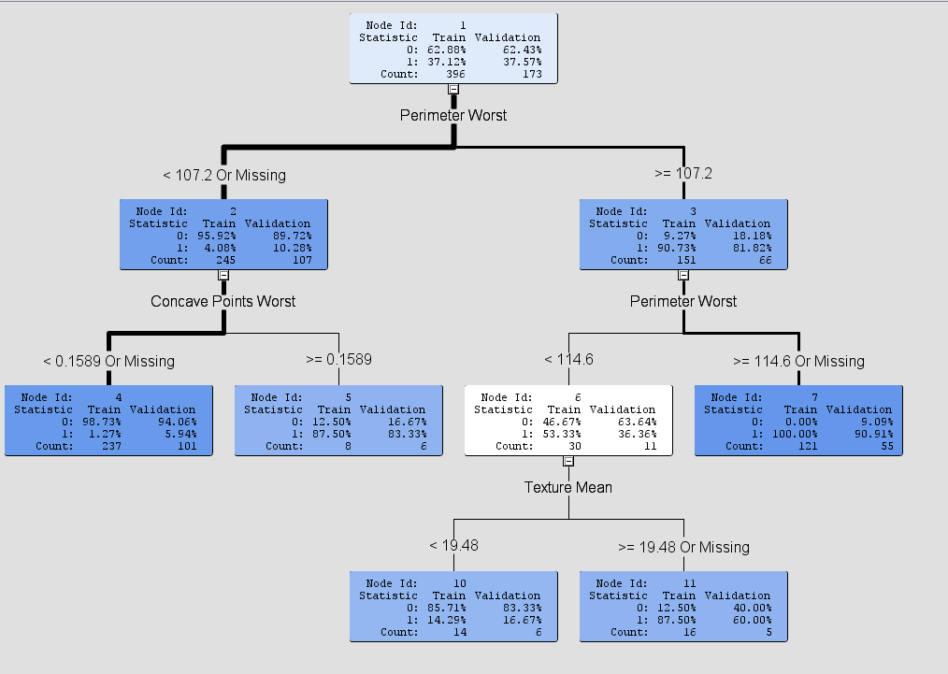
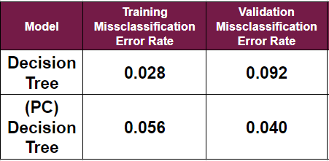
Decision Tree
Naivee Rule .63
Notes:
change full model to decision tree
Various Decision Trees were modeled with variation in
splitting rule criteria:
Default
Entropy
Number of Branches
Decision Tree with highest predictive accuracy is the Decision Tree Grown from the Principal Component Variable Reduction
The PC Decision Tree only had one split utilizing Principle Component one

Slide 21
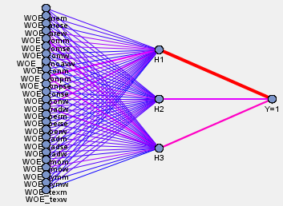
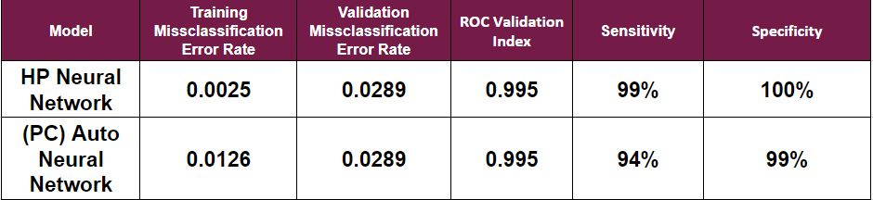
Neural Network
Naivee Rule .63
Number of Input Variables : 25 WOE
Number of Hidden Layers : 1
Number of Hidden Neurons : 3
Number of Weights : 82
Architecture : MLP
Output Layer: 1 Node 1=Malignant 0=Benign
Notes:
Units pass information to other units through connections. Connections are directional and indicate the flow of computation within the network. Connections cannot form loops, because the HP Neural node permits only feed-f
The training of the network was “supervised”
for each case the network was provided with both the input characteristics of the mass and the corresponding FNA diagnosis
Various Neural Networks were constructed for each different Variable Selection Method listed earlier in the analysis- while varying the number of nodes in the hidden layer, input variables, and weights.
Each Neural Network was then compared using the validation misclassification rate as well as the ROC Curve

Slide 22
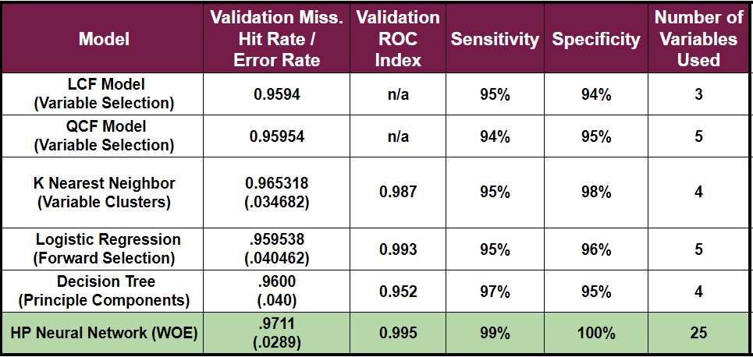
Best Model Selection
Naivee Rule .63
HP Neural Network Superior Model
Correctly Classifies 99% of Malignant Masses and 100% of Benign Masses
Notes:
The HP Neural Network Model Surpasses all other Models across all cut offs of interest under the Validation ROC index criteria.
The HP Neural Network outperforms all other models in terms of misclassification with a validation misclassification error rate of .02891 or 97% accuracy.

Slide 23
Model Recommendations
HP Neural Network is the best model for predictive purposes.
However, for interpretation purposes we favor the Logistic Regression Forward selection model
For every 1 unit increase in the radius standard error of cell nuclei the odds that a patient's mass is malignant increase by 22%
Across five of the six variable selection methods:
Perimeter
Concavity
Texture
Notes:
HP Neural Network has
the highest valiation hit rate (97%)
the highest ROC index (.995)
the highest sensitivity (99%)
Highest specificity (100%)
Odds Radius SE 1-.217 = .783
Thus, in an effort to further improve outcome prediction, I recommend medical professionals look into refining those techniques used to measure and record the perimeter, concavity and texture of a cell’s nucleus within a potentially malignant breast mass.

Slide 24
Conclusions and Recommendations
The HPl Neural Network enables:
Increased levels of diagnostic accuracy
Reduction in time between accurate diagnosis and medical intervention
Reduction in the number of patients who receive both false positives and false negatives
Reduced patient medical costs
Decreased levels of patient anxiety and stress
Notes:
Limitations

Slide 25
Comments and Questions ?

Slide 26
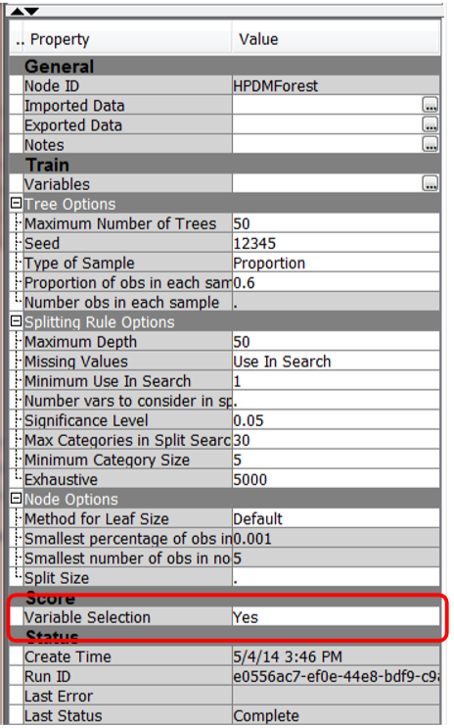

Random Forest Variable Reduction*
Training Data Sampled without replacement
Variables with an out of bag reduction less than or equal to 0 are rejected

Slide 27
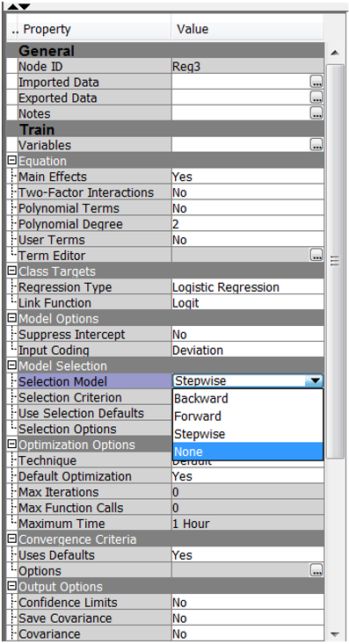

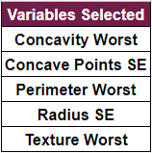
Logistic Regression Variable Reduction
Forward Selection (5)
Backward Selection
Stepwise Selection
Notes:
Regression - Stepwise - considers adding or deleting a variable at each step of the logistic regression process
Forward selection - begins with a simple regression model and adds a predictor one at a time, once a predictor is in the model it can't be taken out of the model
backward selection - begins with a multinomial regression with all predictors in the model and then works backward deletings one variable at a time once a variable is deleted it can not be put back in the model

Slide 28
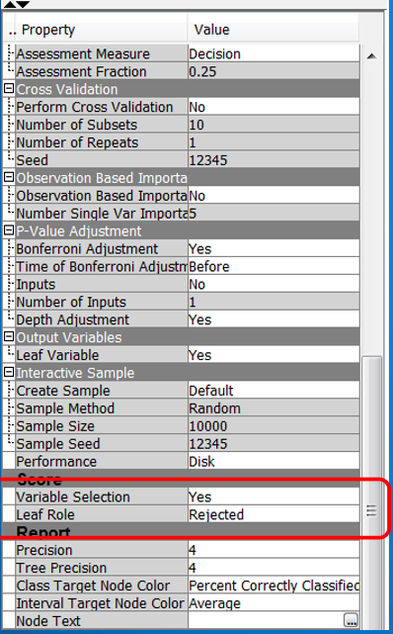

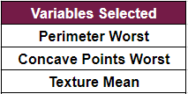
Decision Tree Variable Reduction

Slide 29
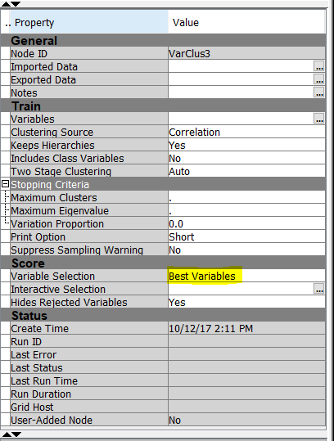

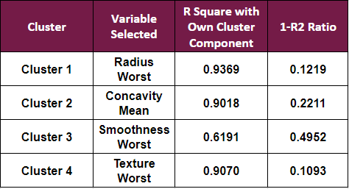
Variable Clustering Variable Reduction
Minimum R-square ratio values
These are the variables that have the highest correlation with its own cluster and the lowest correlation with the next closest cluster.
Notes:
subset of original variables
Best Variable Clustering Technique exports the variables in each cluster that have th

Slide 30
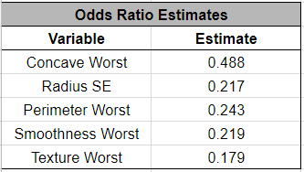
Odds Ratio for Logistic

